Slide 1
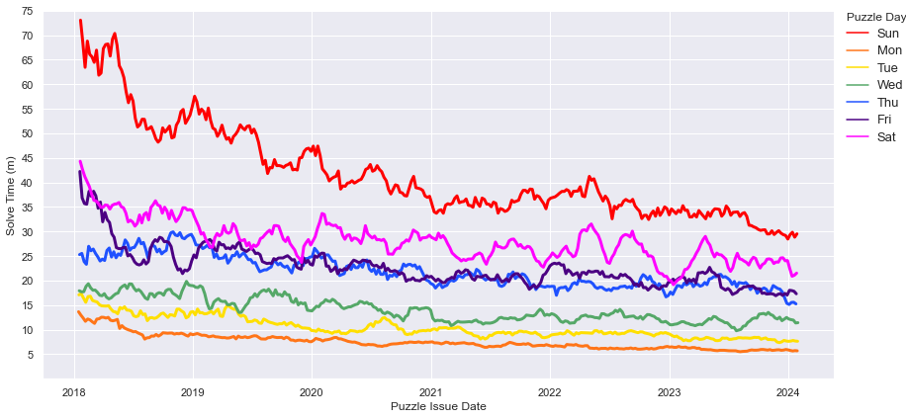
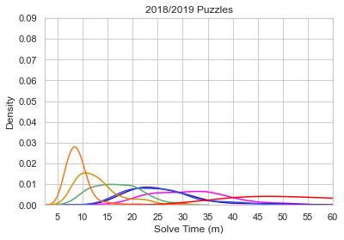
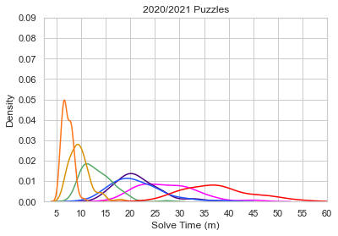
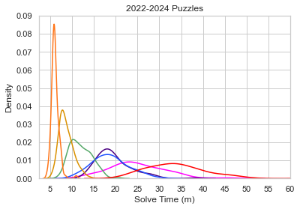
Notes:
Fig. 3 (updated 01312024)

Slide 2
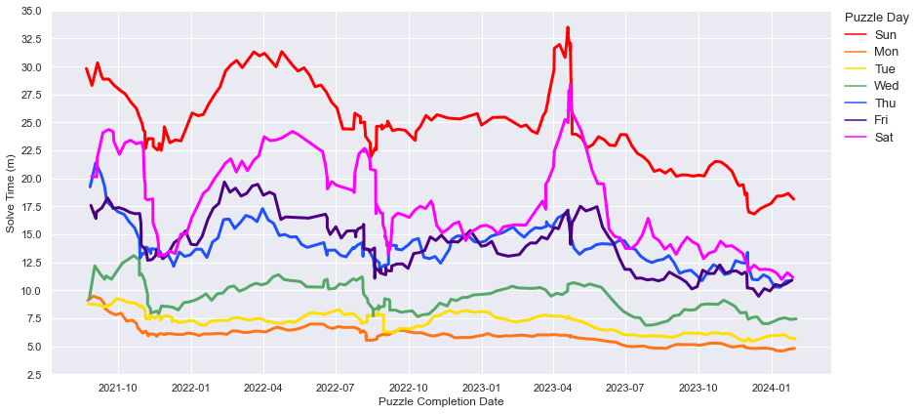
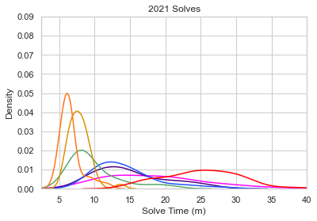
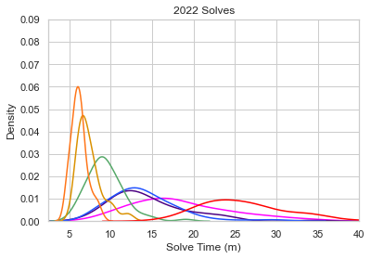
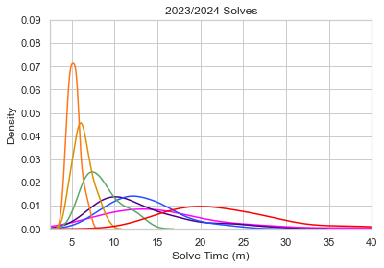
Notes:
Fig. 2

Slide 3
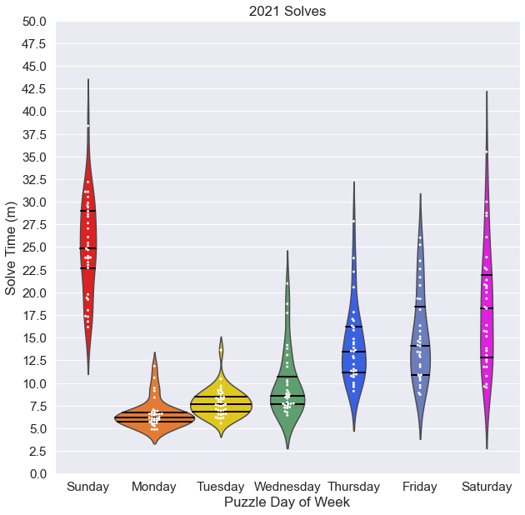
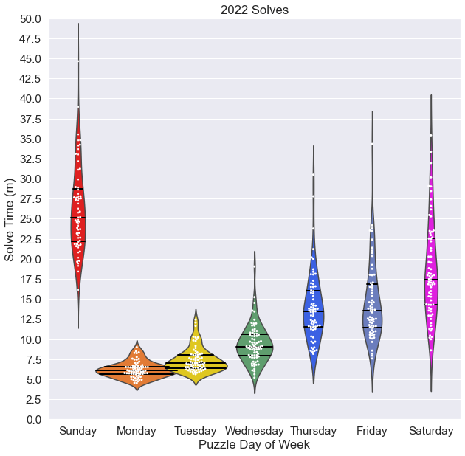
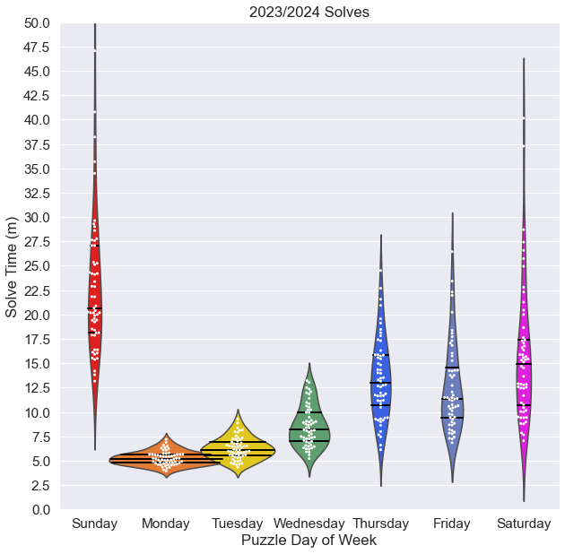
Notes:
Fig. 3

Slide 4
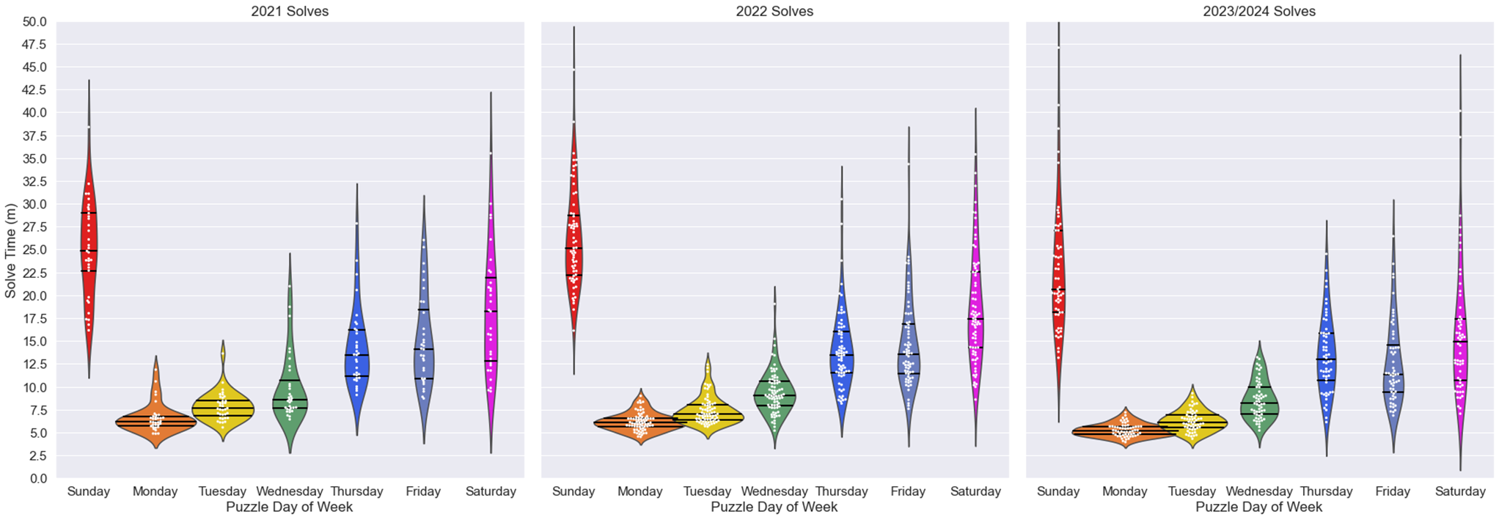
Notes:
Fig. 3

Slide 5
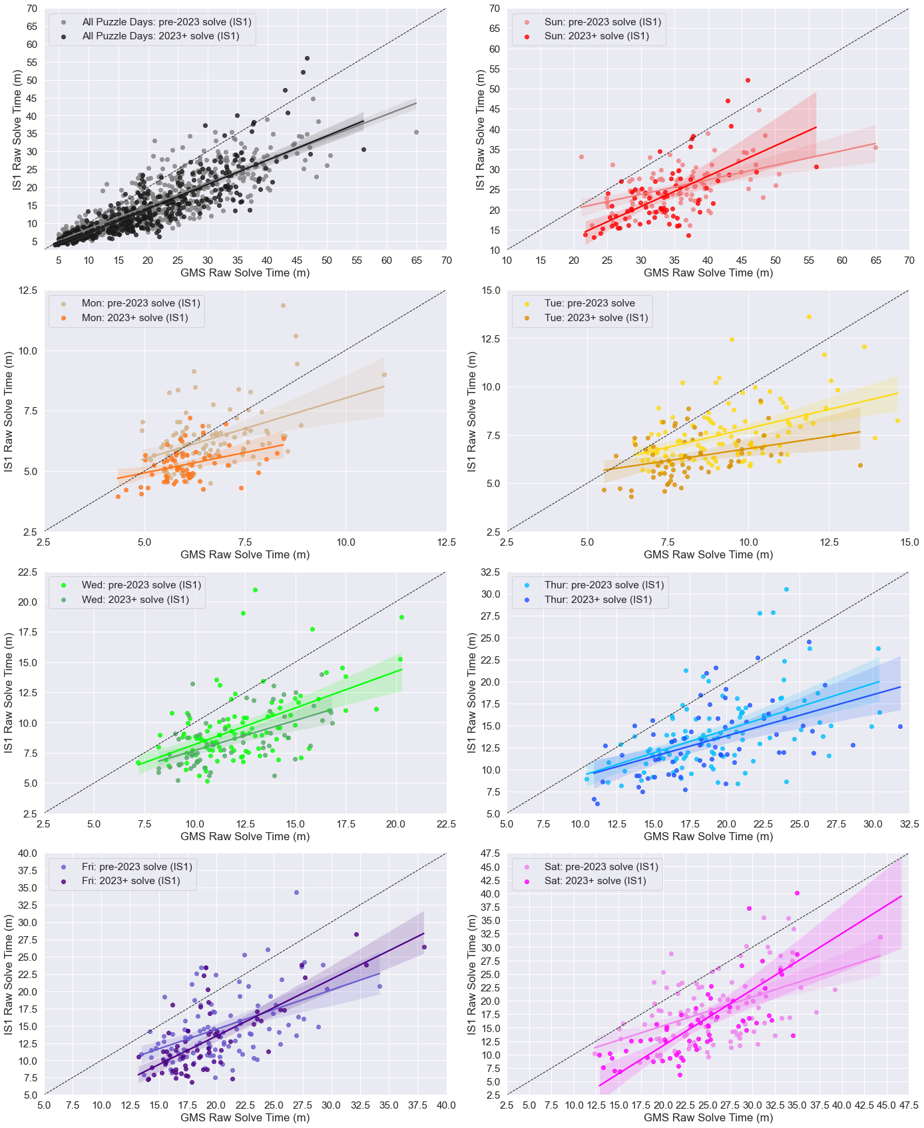
Notes:
Fig 4

Slide 6
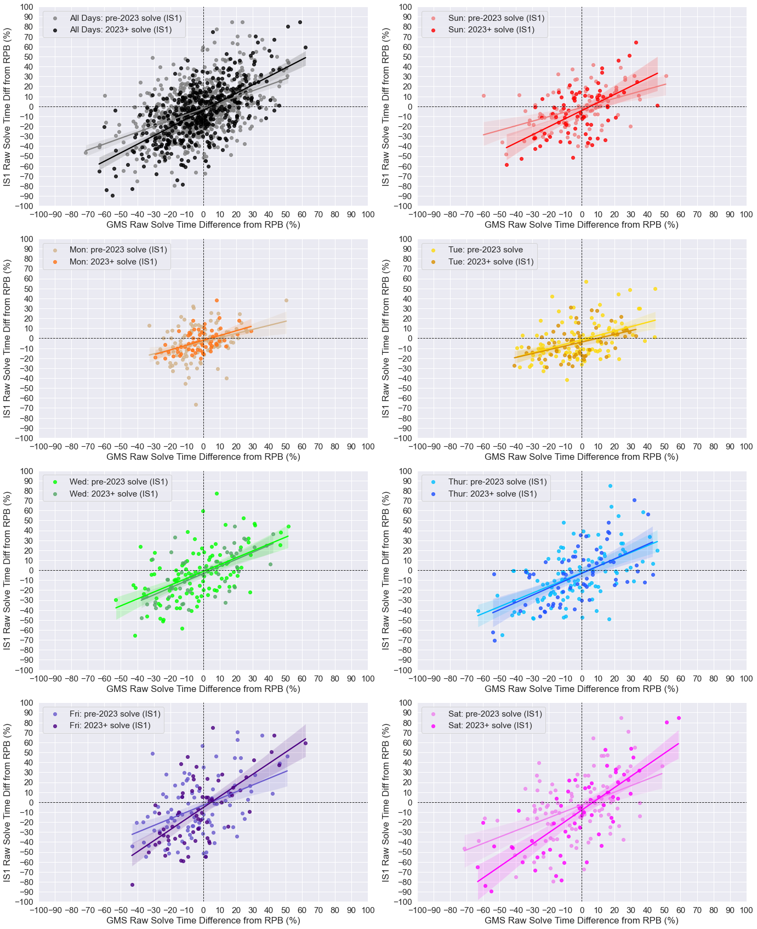
Notes:
Fig 5

Slide 7
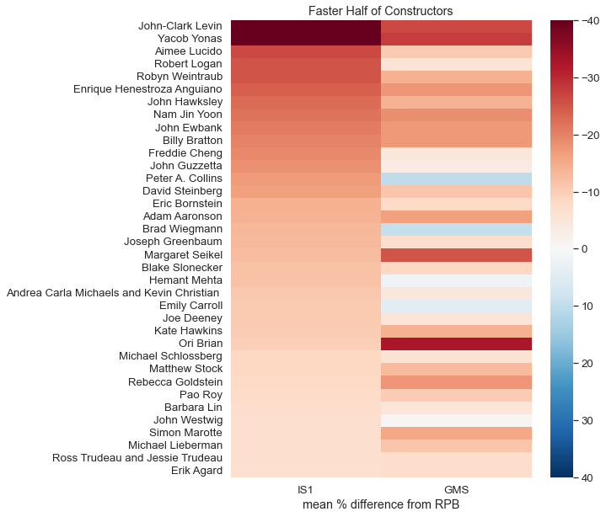
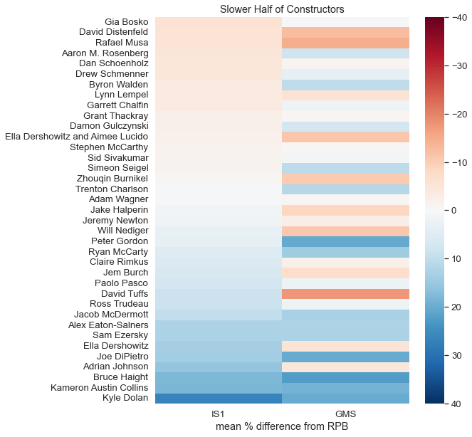
Notes:
Figure 7 live

Slide 8
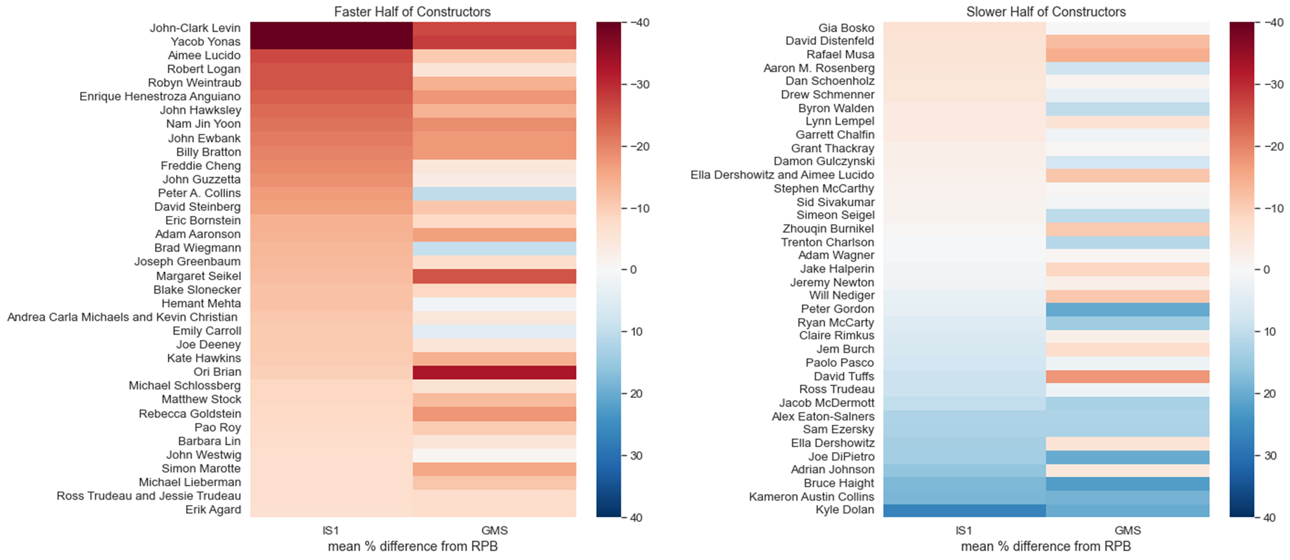
Notes:
Fig 7 flat

Slide 9
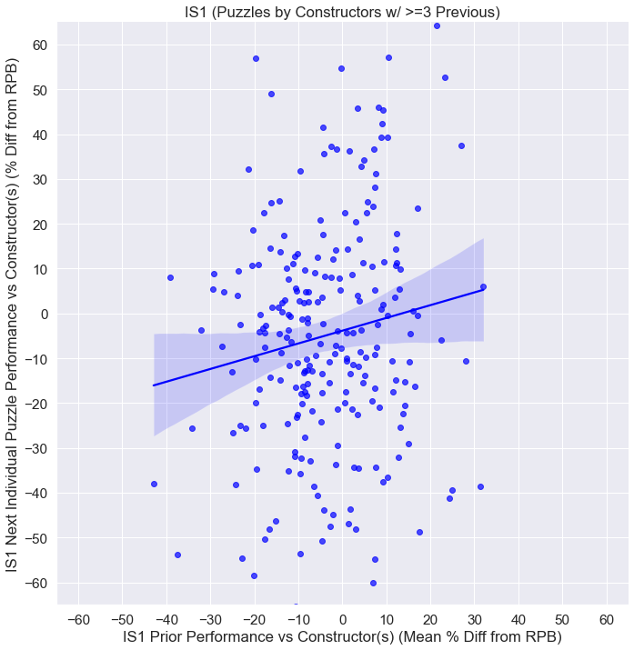
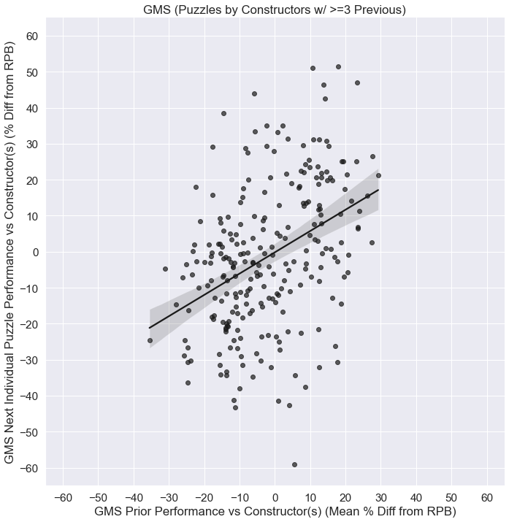
Notes:
Figure 7

Slide 10
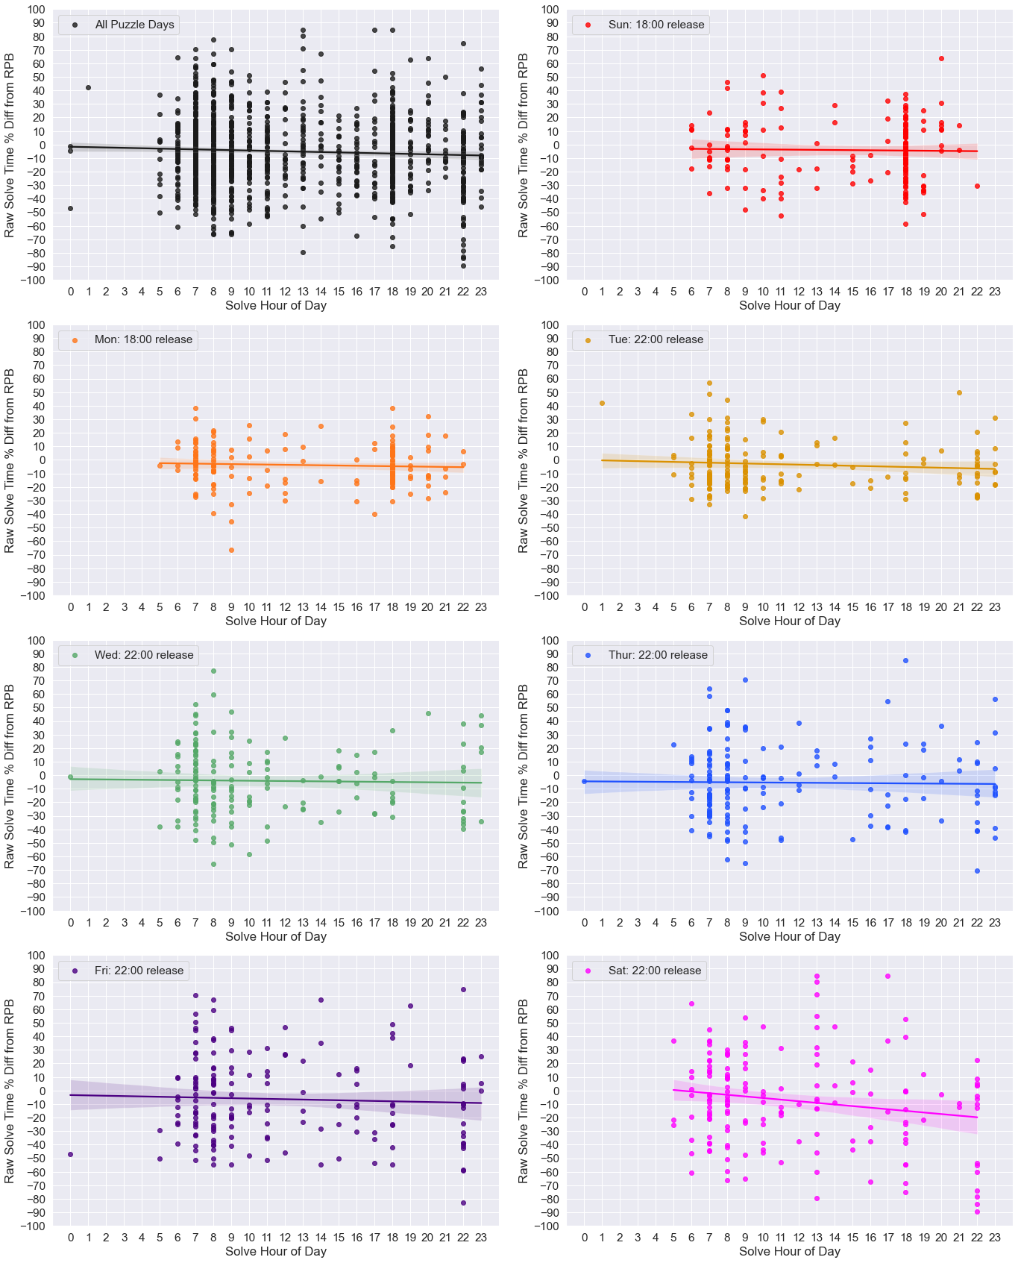
Notes:
Figure 8

Slide 11
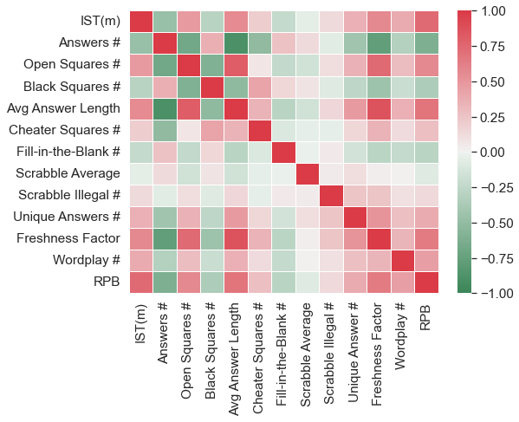
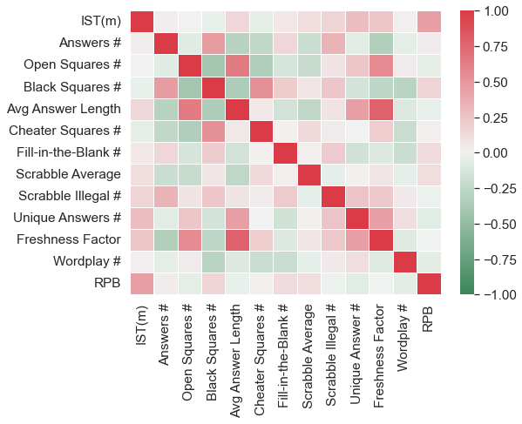
15x15 Puzzles (Mon-Sat)
21x21 Puzzles (Sun)
Clue/Answer
Content
Past
Results
Clue/Answer
Content
Past
Results
Grid Features
Grid Features
Notes:
Figure 9

Slide 12
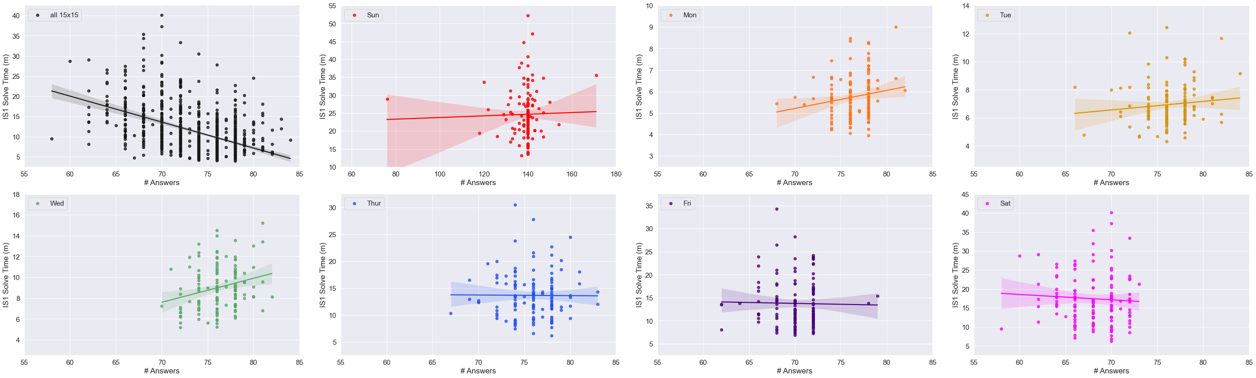
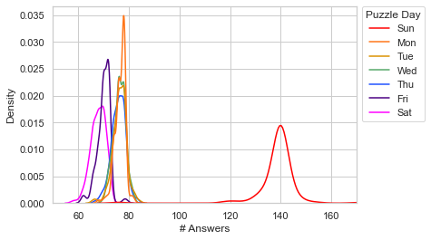
Notes:
Figure 10

Slide 13
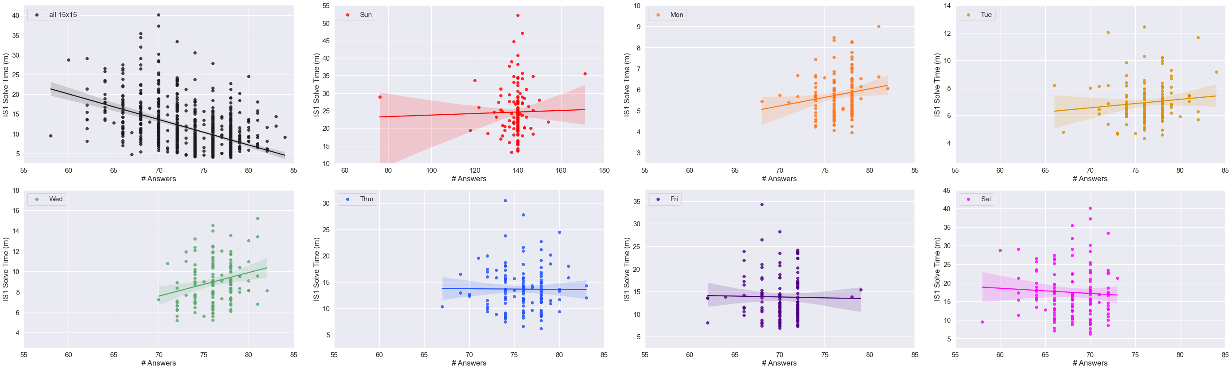
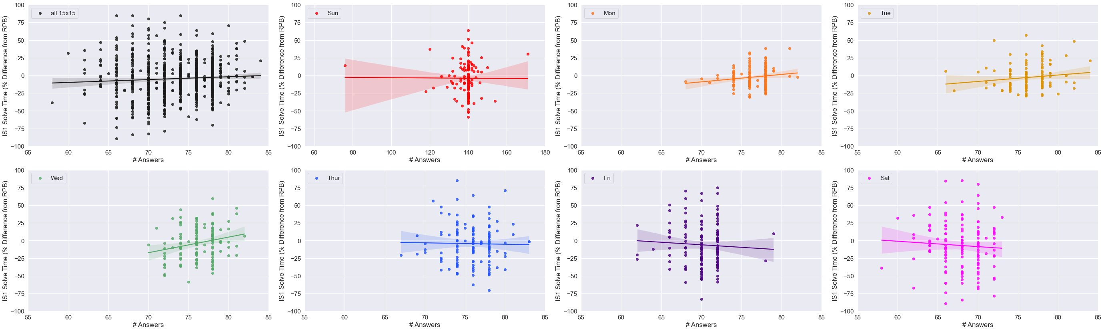
Notes:
Figure 10

Slide 14
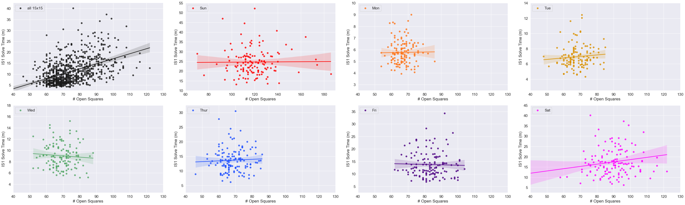
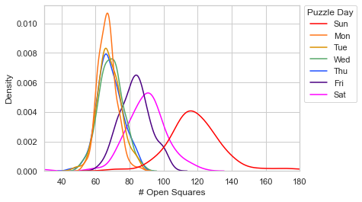
Notes:
Figure 11

Slide 15
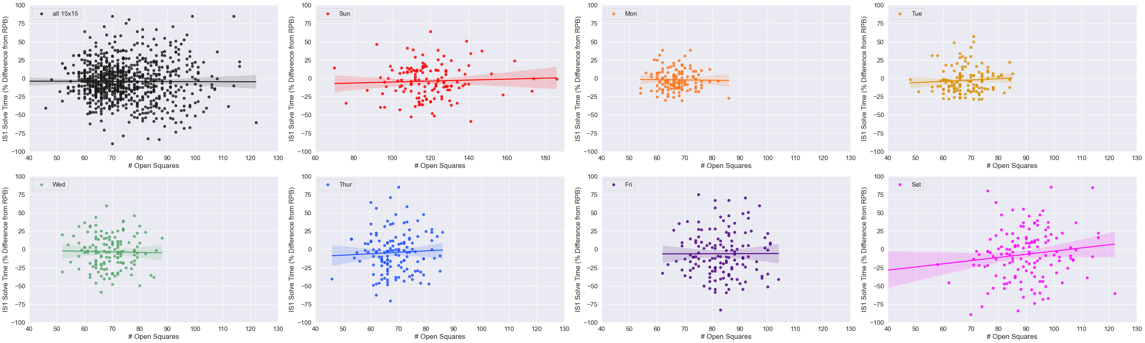

Notes:
Figure 11

Slide 16
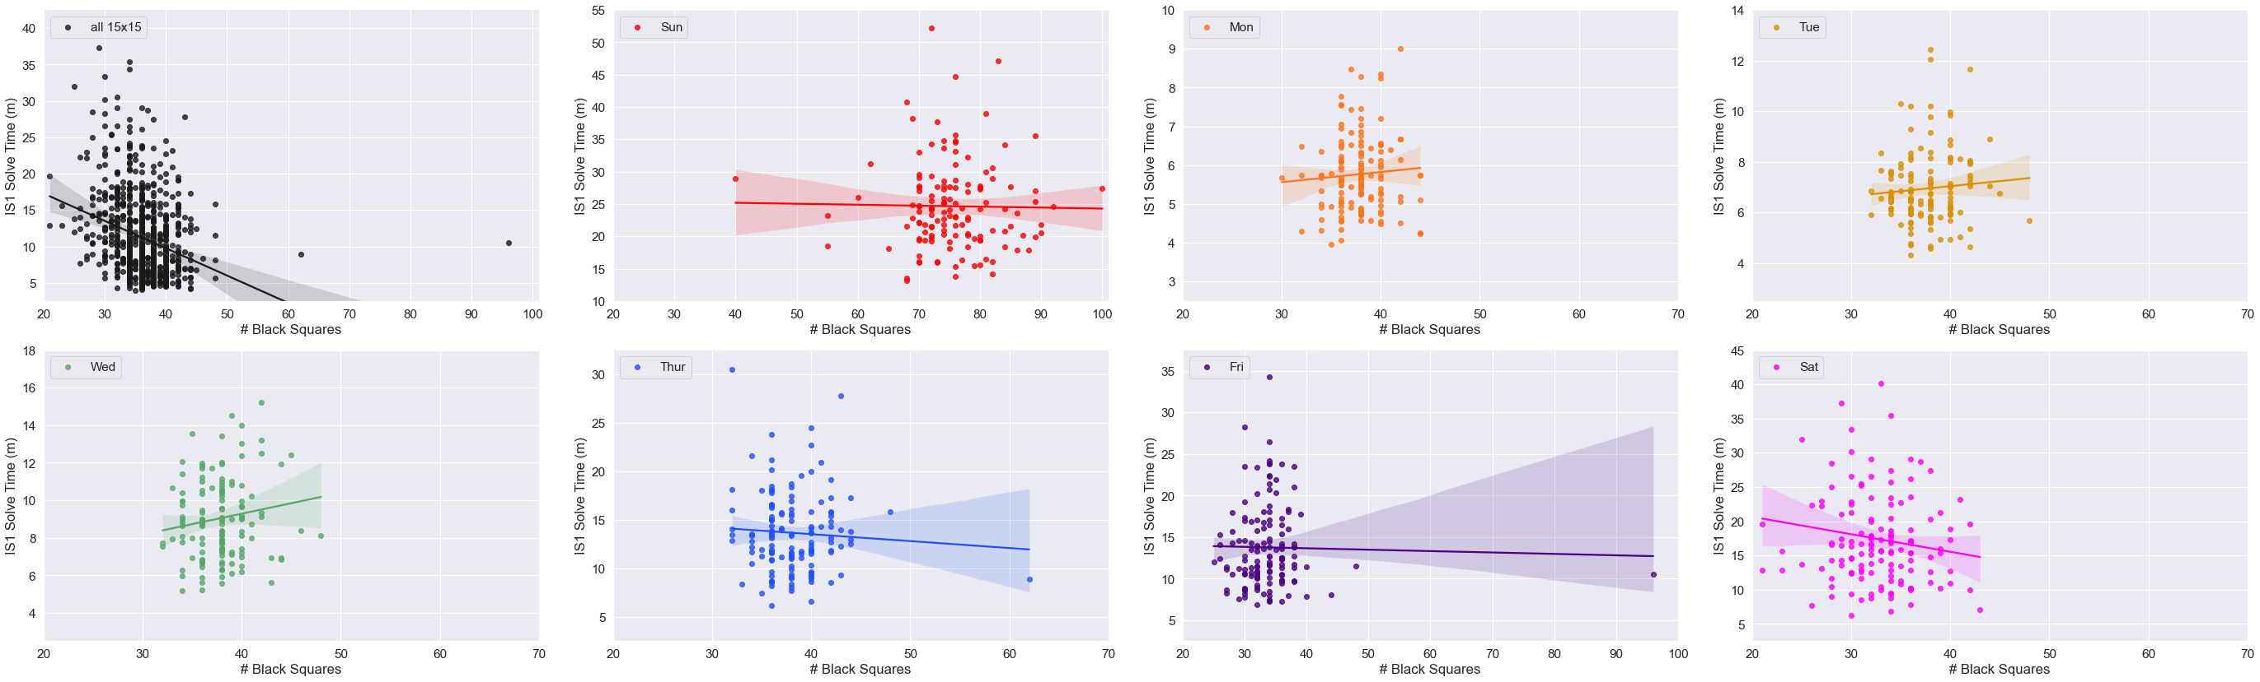
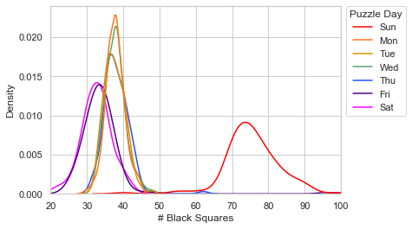
Notes:
Figure 12

Slide 17
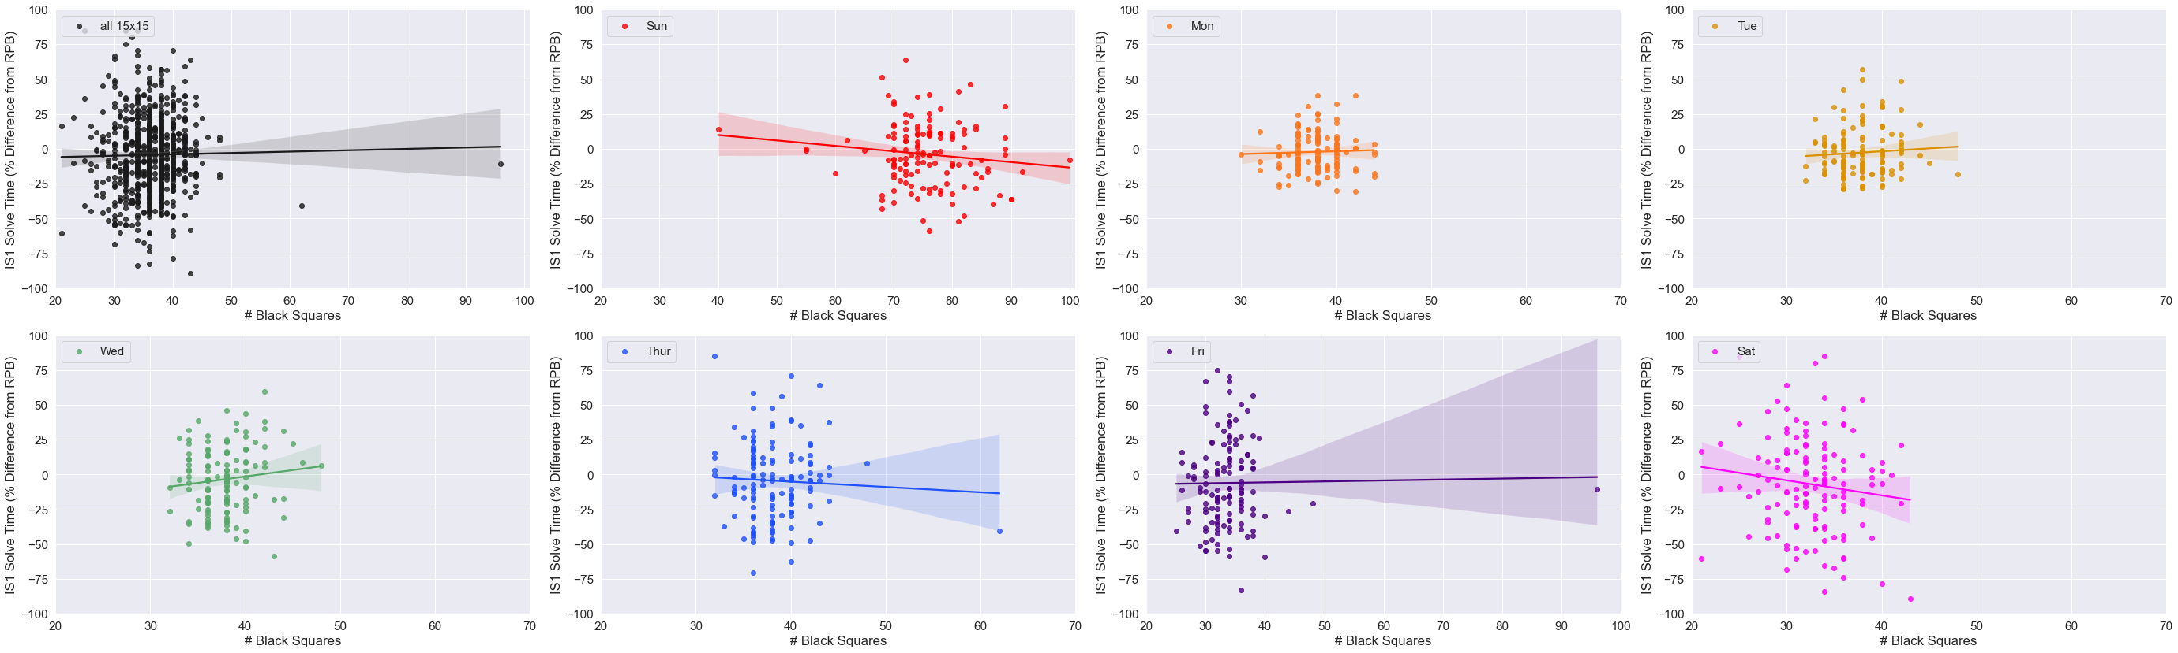

Notes:
Figure 12

Slide 18
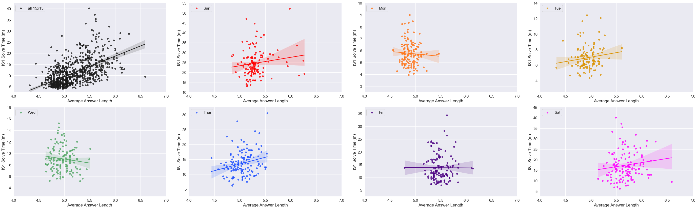
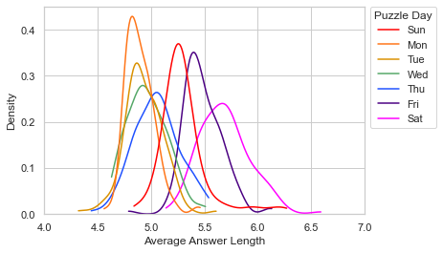
Notes:
Figure 13

Slide 19
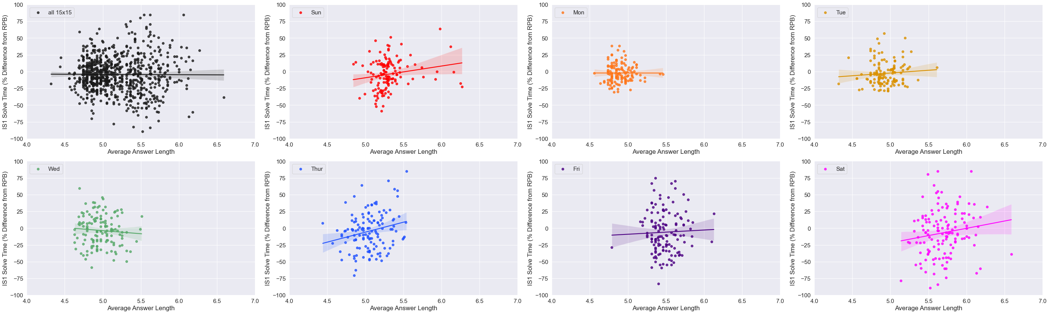

Notes:
Figure 13

Slide 20
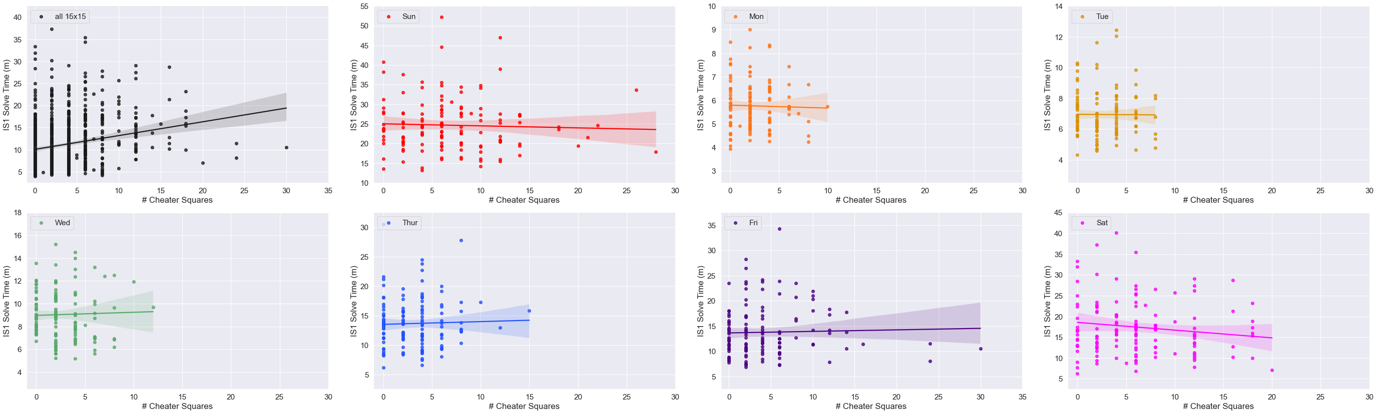
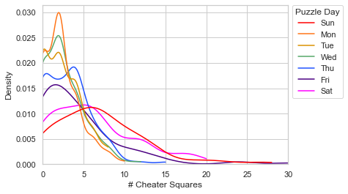
Notes:
Figure 14

Slide 21
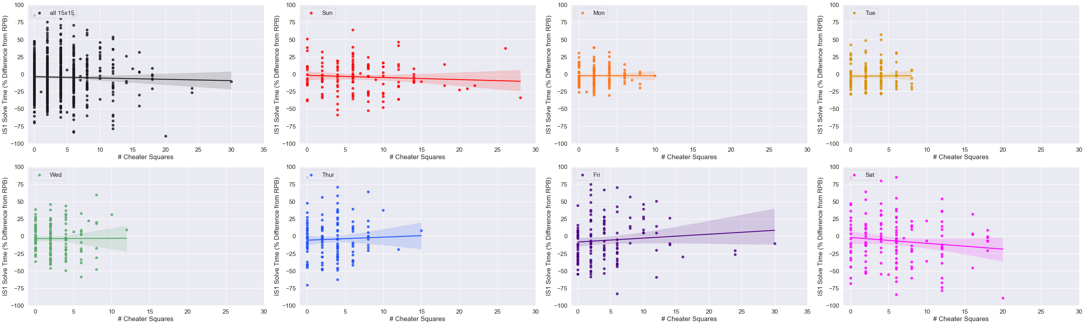
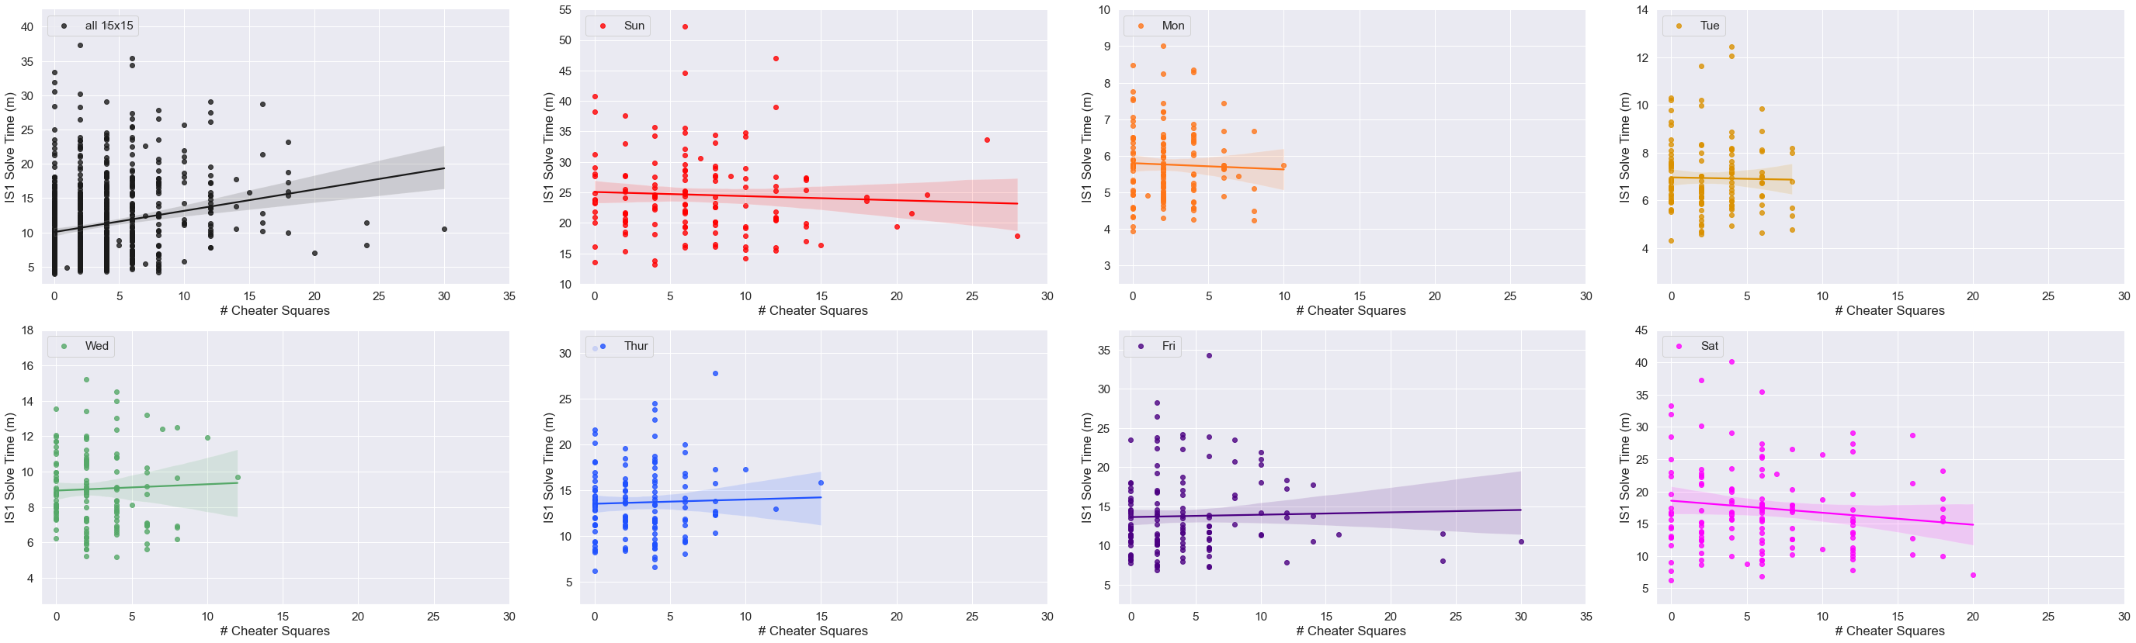
Notes:
Figure 14

Slide 22
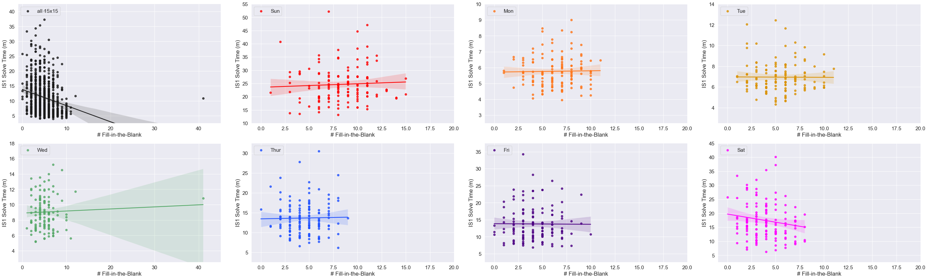
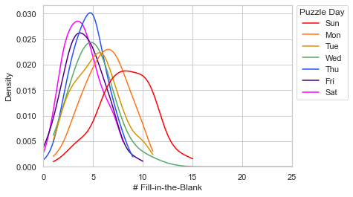
Notes:
Figure 15

Slide 23
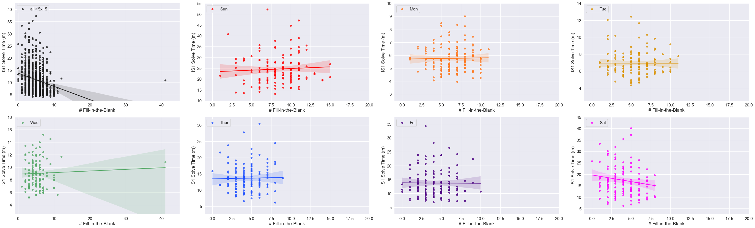
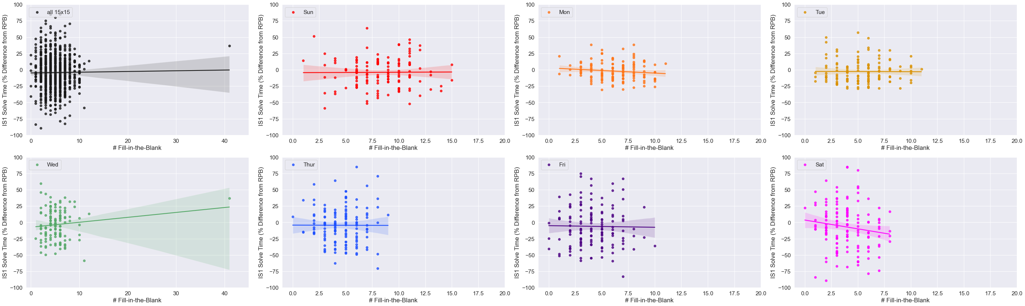
Notes:
Figure 15

Slide 24
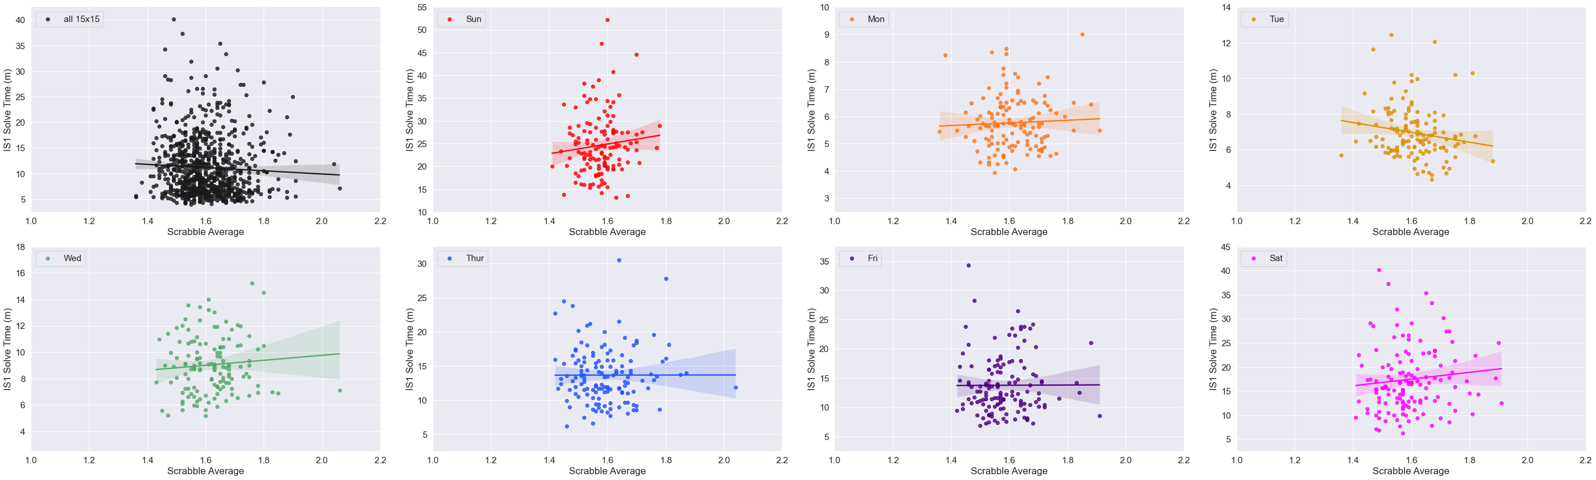
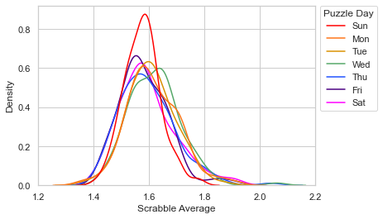
Notes:
Fig. 16

Slide 25
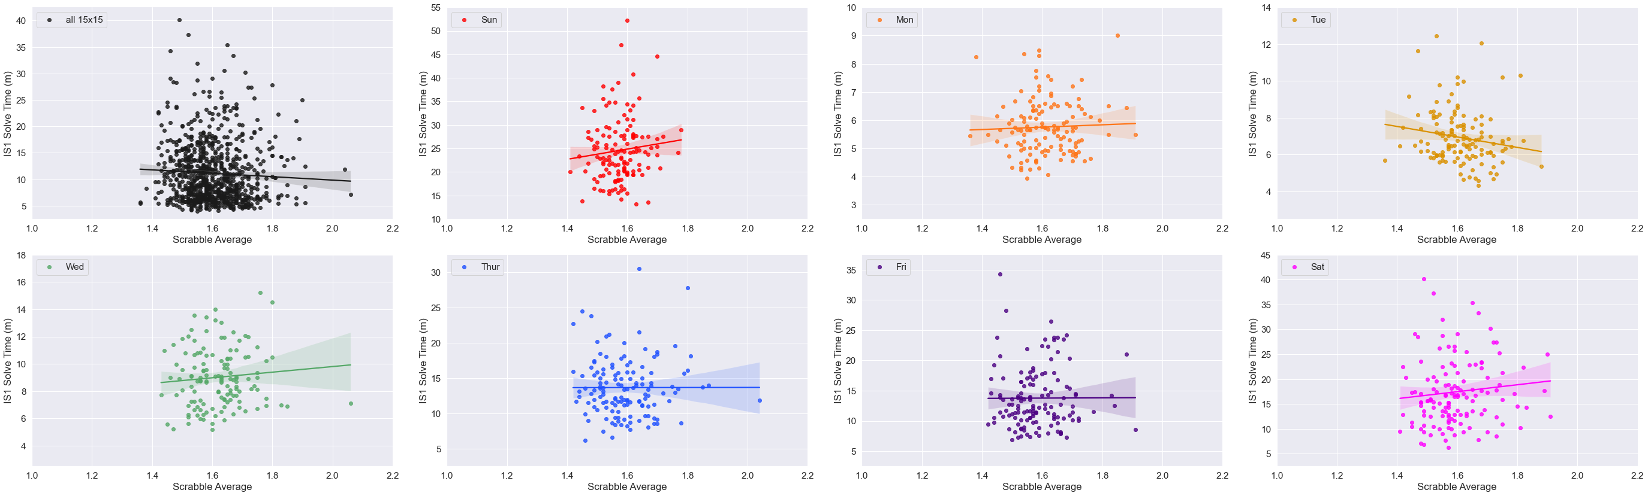
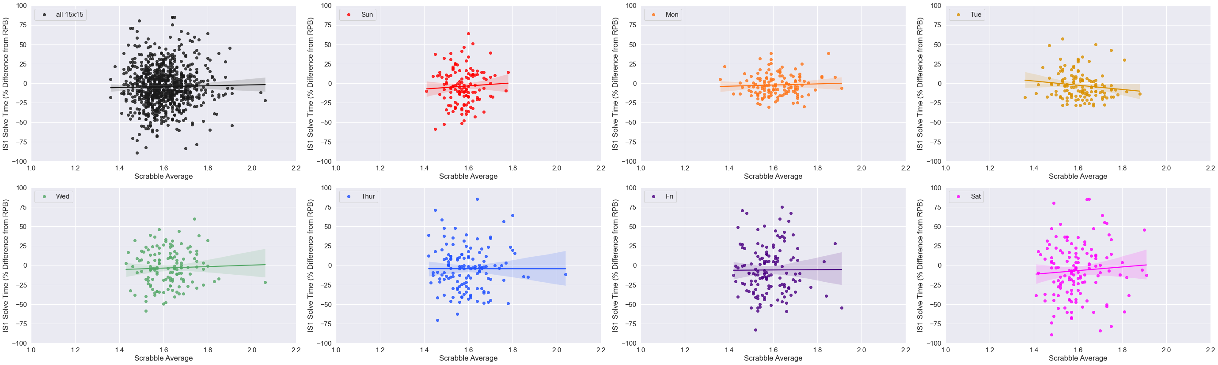
Notes:
Fig. 16

Slide 26
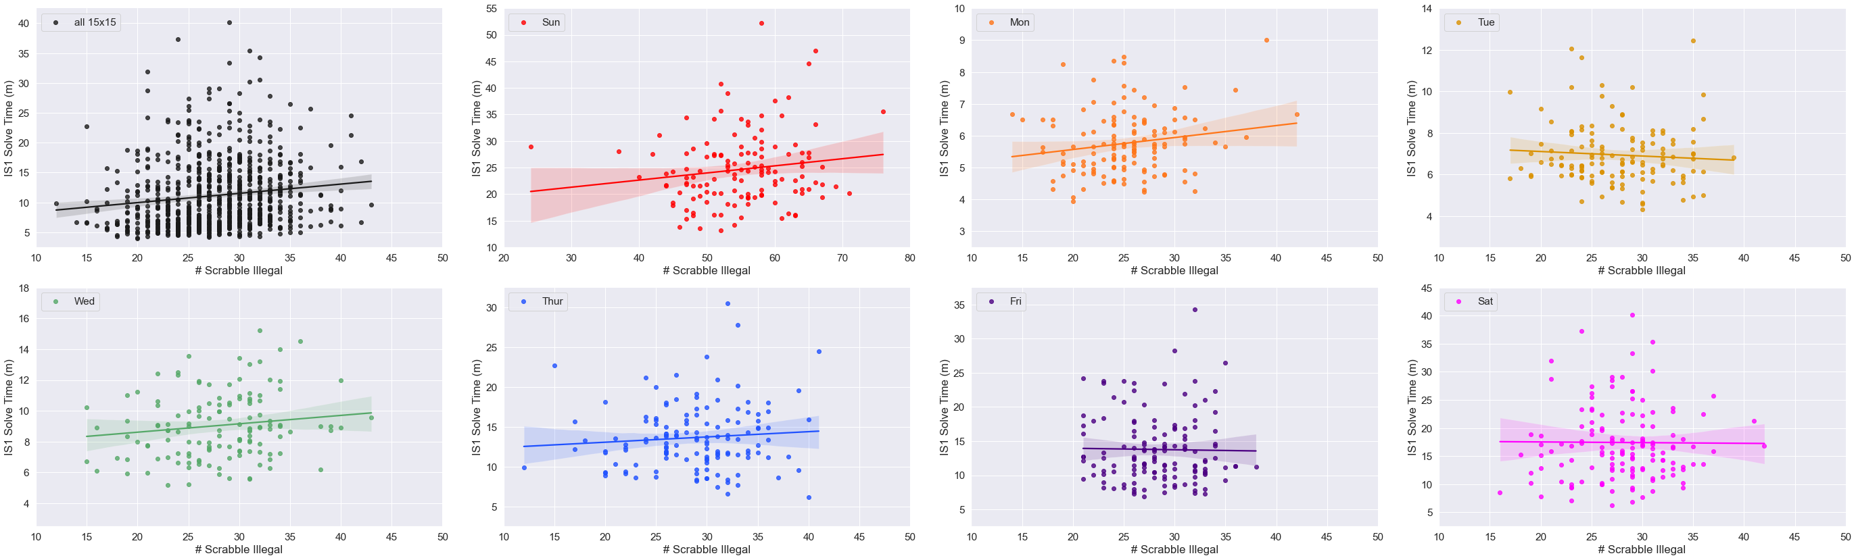
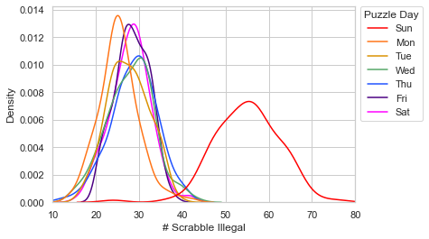
Notes:
Fig. 17

Slide 27

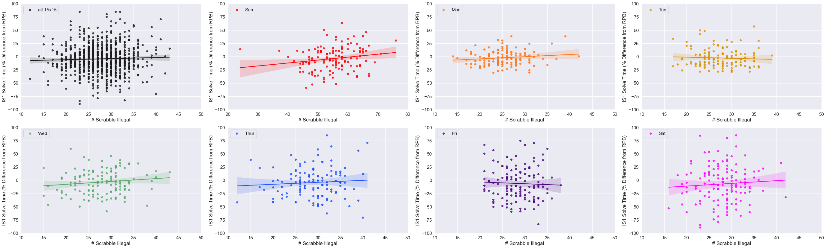
Notes:
Fig. 17

Slide 28


Notes:
Fig. 18

Slide 29


Notes:
Fig. 18

Slide 30


Notes:
Fig. 19

Slide 31


Notes:
Fig. 19

Slide 32


Notes:
Fig. 20

Slide 33


Notes:
Fig. 20

Slide 34

Notes:
Fig. 21

Slide 35
Data Supplement

Slide 36

Notes:
Supplementary Figure 1

Slide 37






Monday
Tuesday
Wednesday
Thursday
Friday
Saturday
Notes:
Supp. Fig.2 live version

Slide 38


Notes:
Supp. Fig. 2 flat version

Slide 39

Notes:
Supplementary Figure 3

Slide 40

Notes:
Supplementary Figure 3

Slide 41

Notes:
Supplementary Figure 3

Slide 42


Notes:
Supplementary Figure 3

Slide 43


Slide 44



